Slide 1

Container Application Load Balancing with Azure Application Gateway for Containers

Slide 2



Load Balancing Portfolio
Standard Load Balancer
VM/VMSS/AKS workloads
L4 passthrough LB
Regional/Global
Application Gateway
VM/VMSS/Hybrid workloads
L7 regional LB
TCP/TLS proxy
WAF
Front Door
VM/VMSS/Hybrid workloads
L7 global LB
TCP/TLS proxy
WAF
Application Gateway for Containers
AKS/container workloads
Dynamic traffic shifting
L7 Ingress Controller
Regional/Global
WAF
Microsoft Confidential
Notes:
Eventually kubic would be for serverless, arc, etc. scenarios

Slide 3
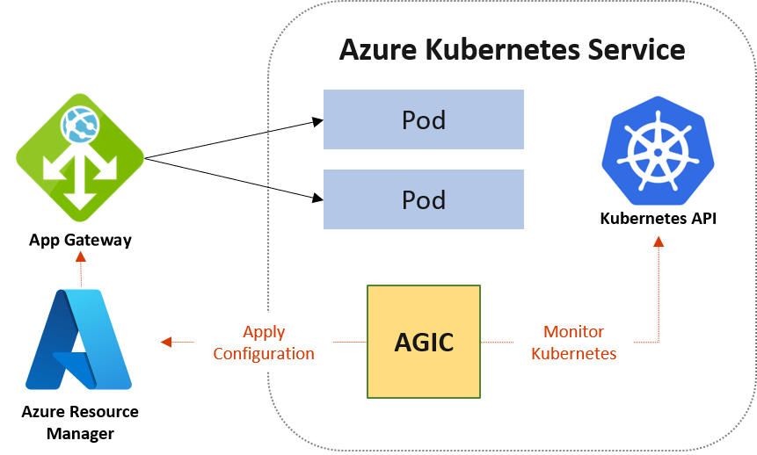
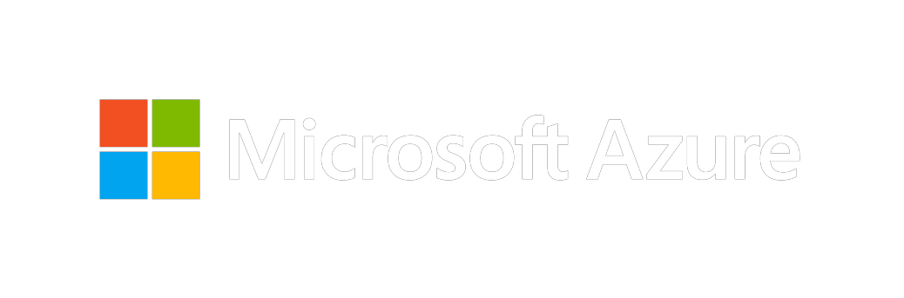
Application Gateway + Ingress Controller (AGIC)
Public / Private regional load balancing
URL routing
Cookie-based affinity
TLS termination
End-to-end TLS
Support for public, private, and hybrid web sites
Integrated web application firewall

Slide 4
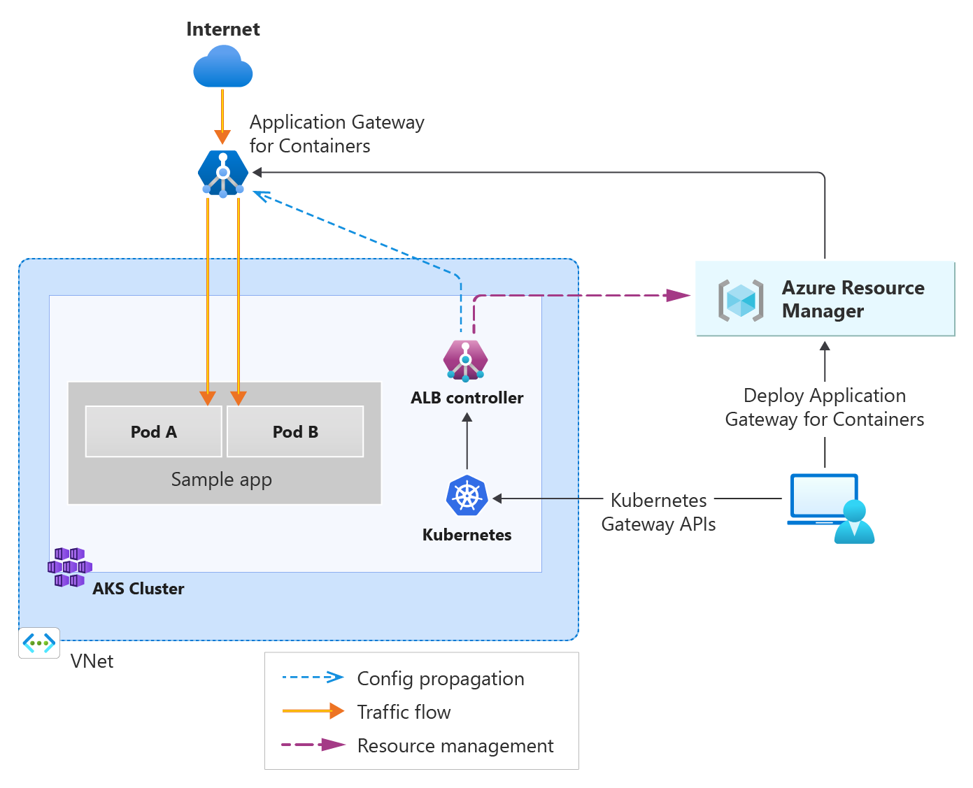

Slide 5
Current state (AGIC) | Successor (AGC)

Slide 6






Application Gateway for Containers (AGC)
Generally Available
Managed Application Load Balancer for Kubernetes
Near real-time configuration updates
External to cluster – offload network compute
Deploy via ARM, Bicep, PowerShell, CLI, Terraform, Gateway API, and Ingress API
TLS offloading, ECDSA+RSA certificate support, and Frontend/Backend Mutual Authentication
Manage resource lifecycle via Kubernetes or Azure
URL / Header Redirect, Rewrite, and Routing
Monitor & Troubleshoot via Azure Monitor, Prometheus, local backend health, and resource status
Weigh traffic for blue/green deployments
HTTP/S, Server-Sent Events, WebSocket, gRPC

Slide 7
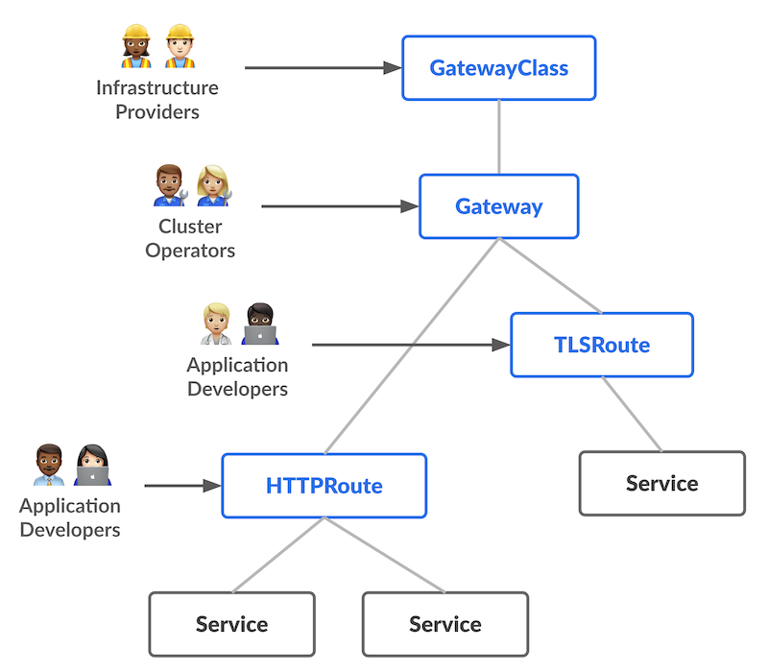
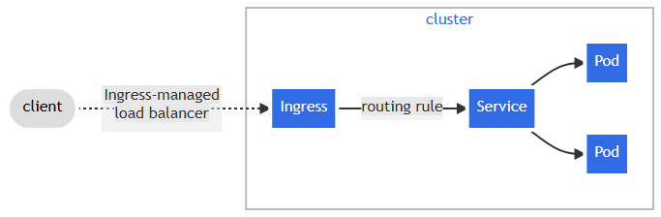
Gateway and Ingress API
Ingress | Kubernetes
Introduction - Kubernetes Gateway API (k8s.io)

Slide 8
Application Gateway for Containers (AGC)
Components of AGC
Azure Resource Manager
AGC
Frontend
Association
Kubernetes
ALB Controller

Slide 9
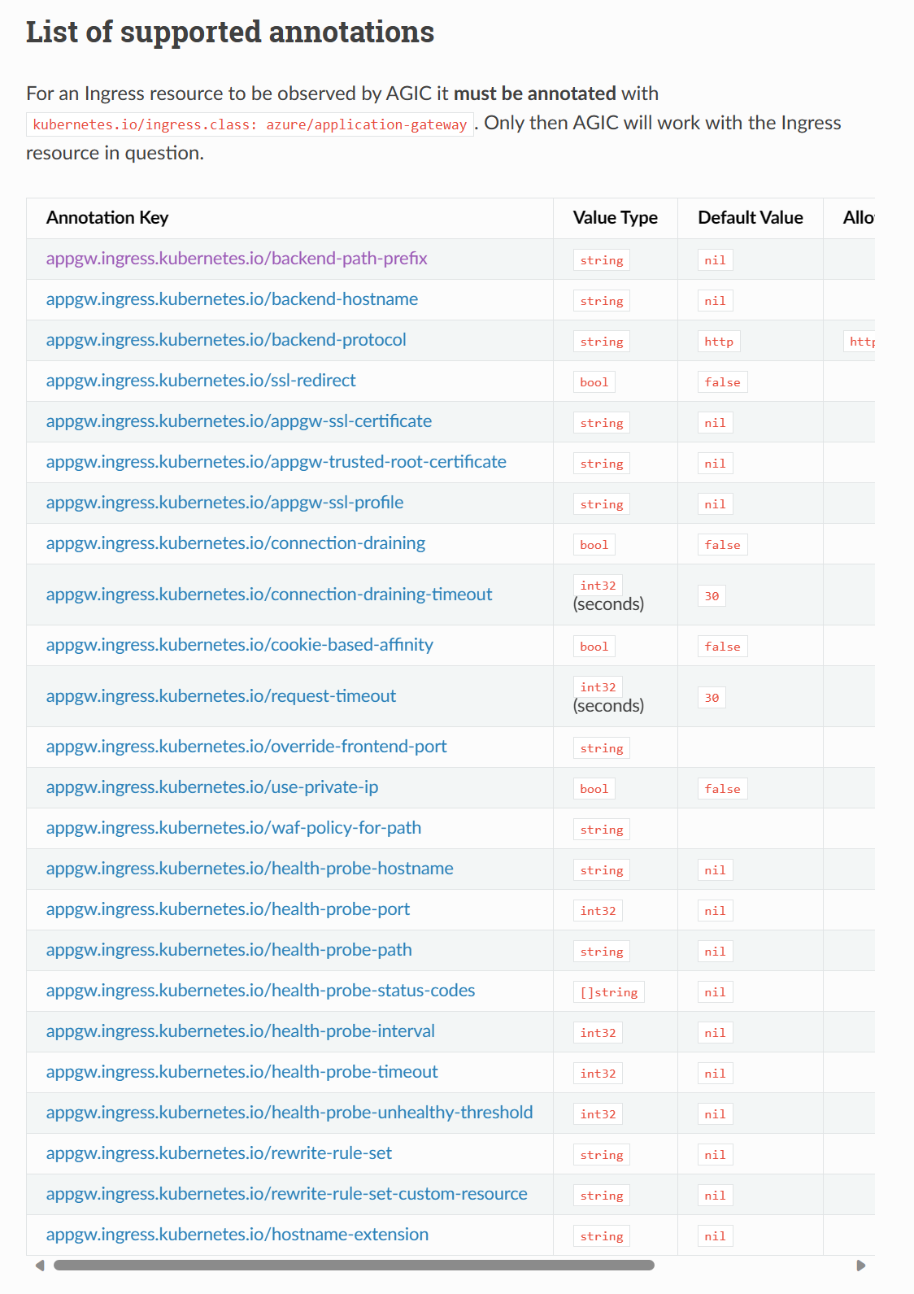
Annotations to Custom Resources
Custom health probe
apiVersion: alb.networking.azure.io/v1
kind: HealthCheckPolicy
metadata:
name: gateway-health-check-policy
namespace: test-infra
spec:
targetRef:
group: ""
kind: Service
name: test-service
namespace: test-infra
default:
interval: 5s
timeout: 3s
healthyThreshold: 1
unhealthyThreshold: 1
protocol: HTTP
http:
host: contoso.com
path: /
match:
statusCodes:
- start: 200
end: 299
Session Affinity
apiVersion: alb.networking.azure.io/v1
kind: IngressExtension
metadata:
name: session-affinity-ingress-extension
namespace: test-infra
spec:
backendSettings:
- service: echo
sessionAffinity:
affinityType: "application-cookie"
cookieName: "nomnom"
cookieDuration: 3600

Slide 10
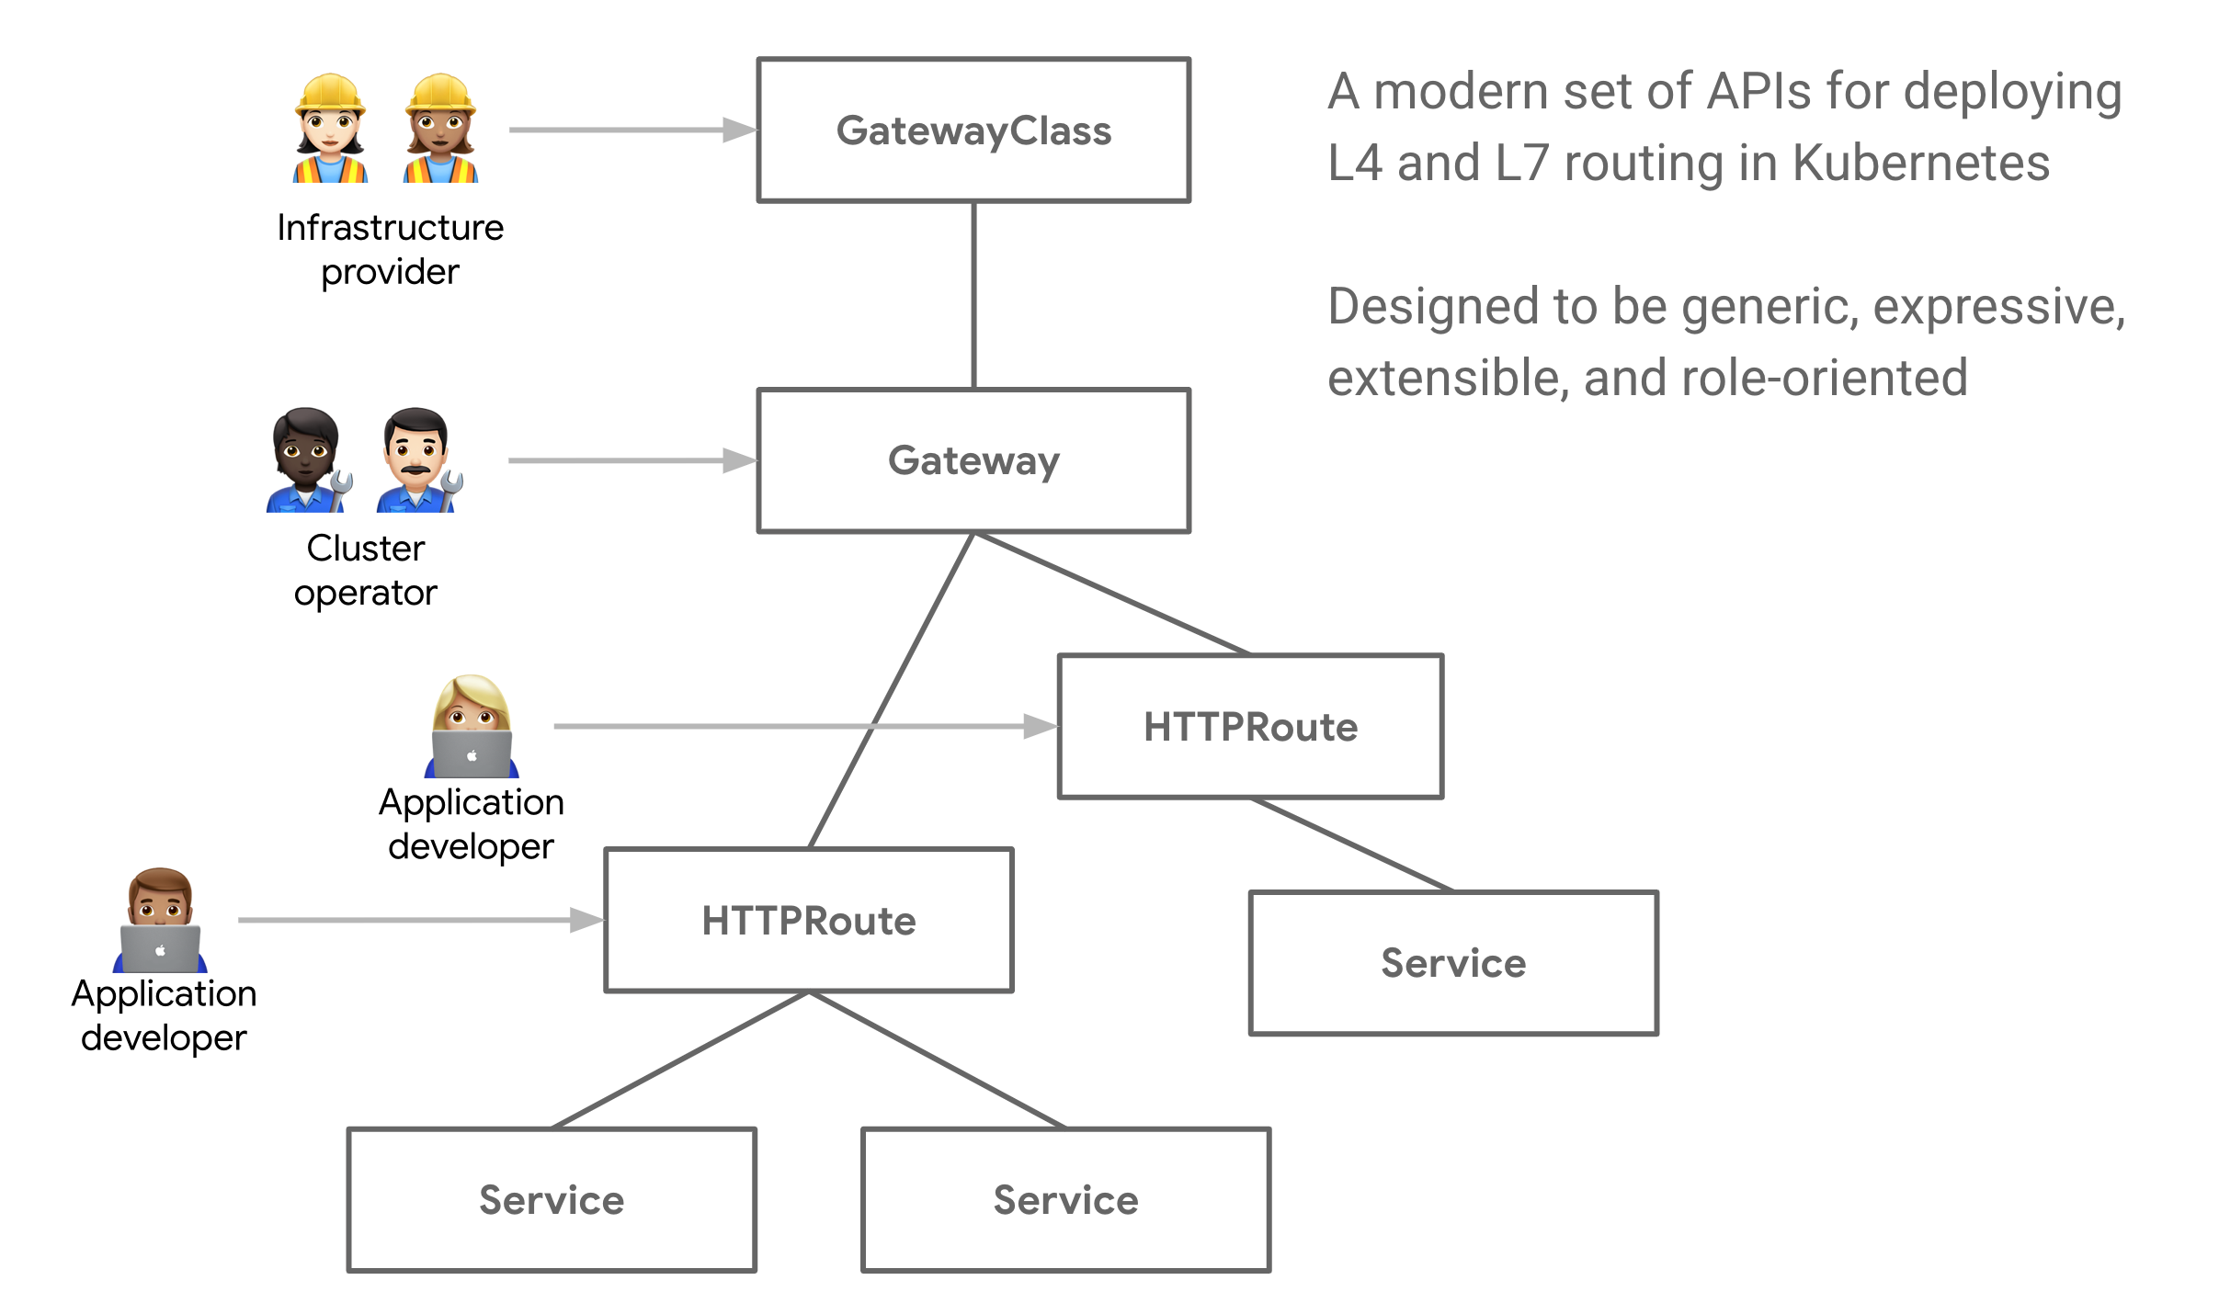
Gateway API
Gateway Resource
apiVersion: gateway.networking.k8s.io/v1beta1
kind: Gateway
metadata:
name: gateway-01
namespace: test-infra
annotations:
alb.networking.azure.io/alb-namespace: alb-test-infra
alb.networking.azure.io/alb-name: alb-test
spec:
gatewayClassName: azure-alb-external
listeners:
- name: http-listener
port: 80
protocol: HTTP
allowedRoutes:
namespaces:
from: Same
HTTPRoute resource
apiVersion: gateway.networking.k8s.io/v1beta1
kind: HTTPRoute
metadata:
name: rewrite-example
namespace: test-infra
spec:
parentRefs:
- name: gateway-01
hostnames:
- "contoso.com"
rules:
- matches:
- path:
type: PathPrefix
value: /shop
filters:
- type: URLRewrite
urlRewrite:
path:
type: ReplacePrefixMatch
replacePrefixMatch: /ecommerce
backendRefs:
- name: backend-v1
port: 8080
- backendRefs:
- name: backend-v2
port: 8080
Introduction - Kubernetes Gateway API (k8s.io)

Slide 11
What is the problem with annotations ?
Ingress API: NGINX example apiVersion: networking.k8s.io/v1
kind: Ingress
metadata:
annotations:
nginx.ingress.kubernetes.io/rewrite-target: /
nginx.ingress.kubernetes.io/proxy-body-size: 20m
nginx.ingress.kubernetes.io/proxy-read-timeout: "120"
spec:
rules:
- host: app.example.com
http:
paths:
- path: /
backend:
serviceName: app
servicePort: 80
Gateway API in AGFC
apiVersion: gateway.networking.k8s.io/v1
kind: HTTPRoute
spec:
hostnames: ["app.example.com"]
rules:
- matches:
- path:
type: PathPrefix
value: /
backendRefs:
- name: app
port: 80
filters:
- type: URLRewrite
urlRewrite:
path:
type: ReplacePrefixMatch
replacePrefixMatch: "/"
You need annotations for:
rewrite rules
body size
timeout
session affinity
LB policy
anything beyond basic routing

Slide 12
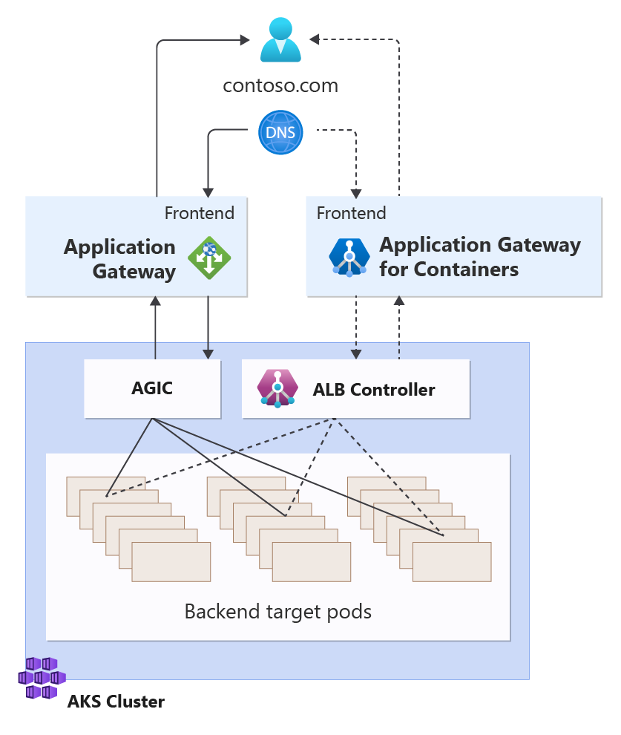
Migration to Application Gateway for Containers
Parallel migration
Enable an incremental migration approach
Allow for end-to-end validation prior to migration
Ensure no downtime

Slide 13
Demo Scenarios

Slide 14
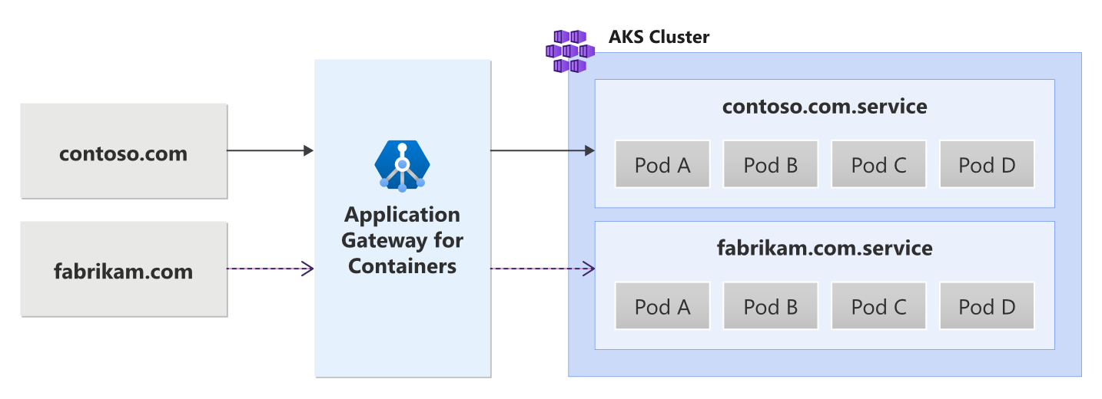
Multi-Site hosting
Support 200 unique hostnames on a single AGC resource
Multiple site hosting with Application Gateway for Containers - Gateway API | Microsoft Learn

Slide 15
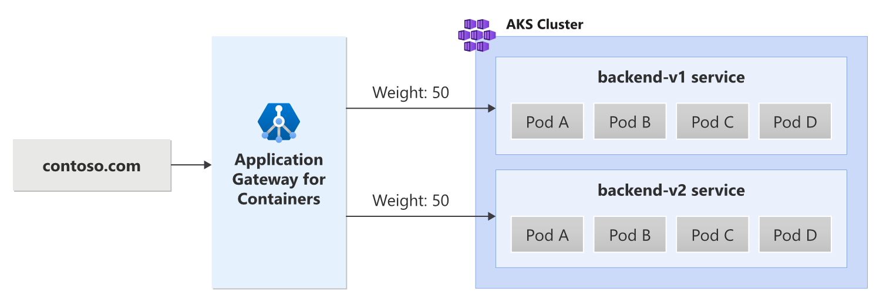
Traffic Splitting / Weighted Round Robin
Weights can be added per service
Excellent for blue/green deployments
Traffic Splitting with Application Gateway for Containers - Gateway API | Microsoft Learn

Slide 16
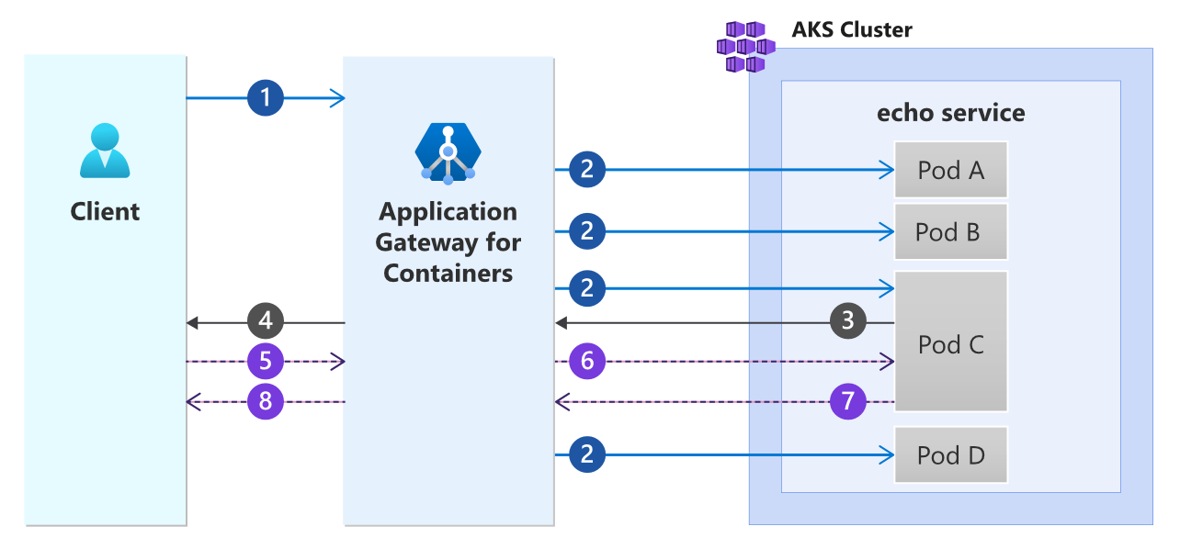
Session Affinity
Establish connections to a previously connected backend
The following steps are depicted in the previous diagram:
A client initiates a request to an Application Gateway for Containers' (Application Gateway for Containers) frontend.
Application Gateway for Containers selects one of the many available pods to load balance the request to. In this example, we assume Pod C is selected out of the four available pods.
Pod C returns a response to Application Gateway for Containers.
In addition to the backend response from Pod C, Application Gateway for Containers adds a Set-Cookie header containing a uniquely generated hash used for routing.
The client sends another request to Application Gateway for Containers along with the session affinity cookie set in the previous step.
Application Gateway for Containers detects the cookie and selects Pod C to serve the request.
Pod C responds to Application Gateway for Containers.
Application Gateway for Containers returns the response to the client
Session affinity overview for Azure Application Gateway for Containers | Microsoft Learn

Slide 17
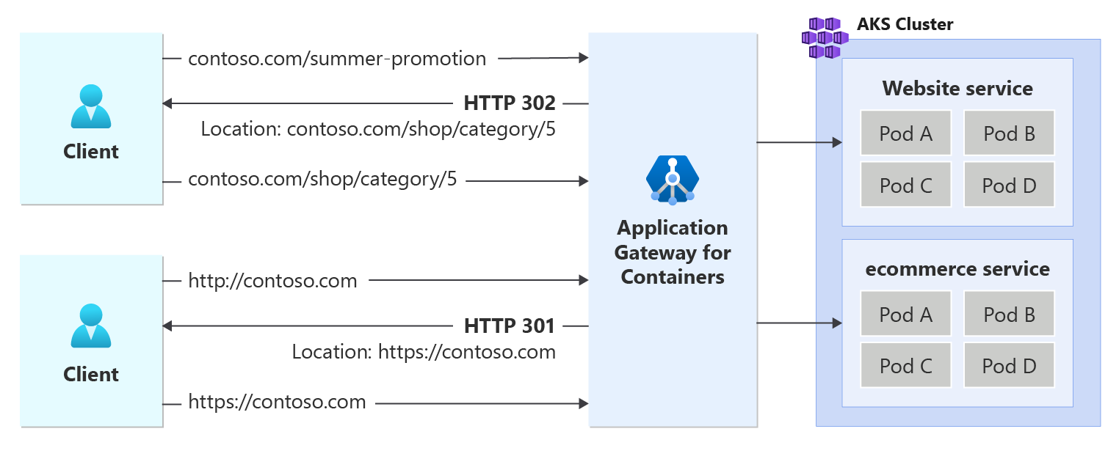
Redirect Support
Redirect based on protocol, host, or path
URL Redirect for Azure Application Gateway for Containers - Gateway API | Microsoft Learn

Slide 18
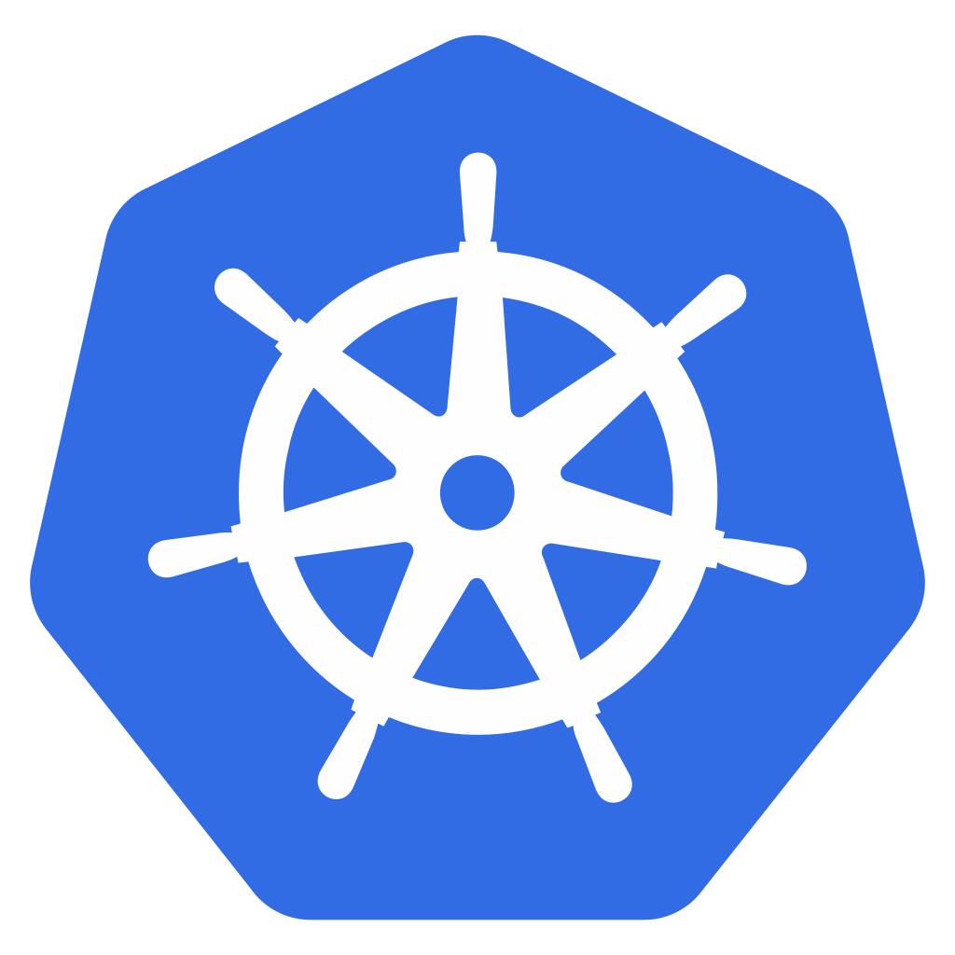

Slow Start
Normal Distribution
Slow Start
RPS
RPS
Application Gateway for Containers
Time
Time
Configure ramp up of traffic to new pods of a service
Control window (duration of slow start), aggression factor, and starting weight
AKS Cluster
Pod 1
Pod 2
Pod 3

Slide 19
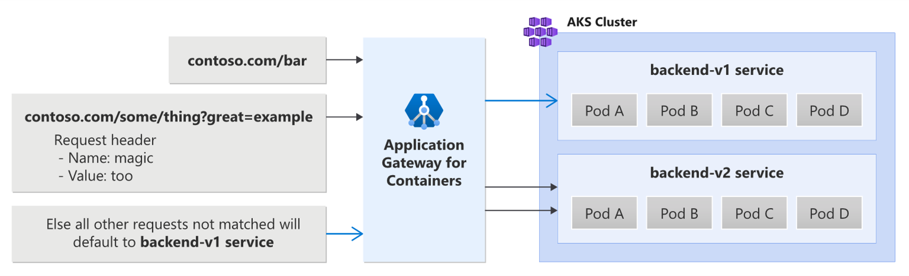
Path, Header, and Query String Routing
Route requests by:
Path
Query String
Header Value
Path, header, and query string routing with Application Gateway for Containers - Gateway API | Microsoft Learn

Slide 20
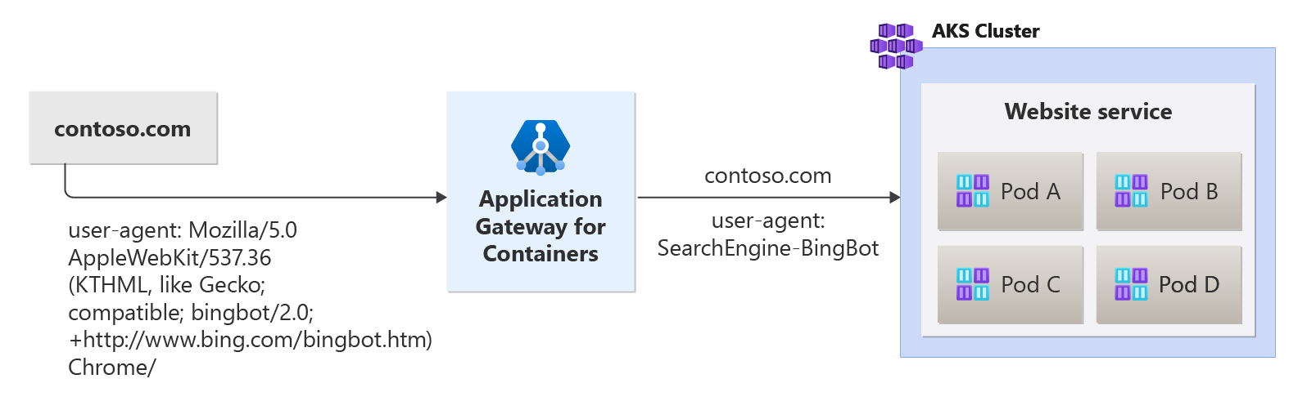
Header Rewrite
Adjust request and response headers
Header rewrite for Azure Application Gateway for Containers - Gateway API | Microsoft Learn

Slide 21
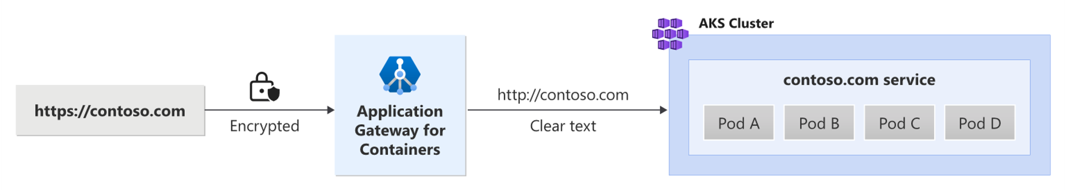
TLS (SSL) Offloading
Offload TLS termination to AGC
SSL offloading with Application Gateway for Containers - Gateway API | Microsoft Learn

Slide 22
TLS Policy
Predefined policy names | 2023-06 | 2023-06-S
Minimum protocol version | TLS 1.2 | TLS 1.2
Enabled protocol versions | TLS 1.2 | TLS 1.2
TLS_AES_256_GCM_SHA384 | ✓ | ✓
TLS_AES_128_GCM_SHA256 | ✓ | ✓
TLS_ECDHE_ECDSA_WITH_AES_256_GCM_SHA384 | ✓ | ✓
TLS_ECDHE_ECDSA_WITH_AES_128_GCM_SHA256 | ✓ | ✓
TLS_ECDHE_RSA_WITH_AES_256_GCM_SHA384 | ✓ | ✓
TLS_ECDHE_RSA_WITH_AES_128_GCM_SHA256 | ✓ | ✓
TLS_ECDHE_ECDSA_WITH_AES_256_CBC_SHA384 | ✓ | ✗
TLS_ECDHE_ECDSA_WITH_AES_128_CBC_SHA256 | ✓ | ✗
TLS_ECDHE_RSA_WITH_AES_256_CBC_SHA384 | ✓ | ✗
TLS_ECDHE_RSA_WITH_AES_128_CBC_SHA256 | ✓ | ✗
Elliptical curves
P-384 | ✓ | ✓
P-256 | ✓ | ✓
Enforce a stricter cipher set
Requires TLS 1.2 and greater

Slide 23
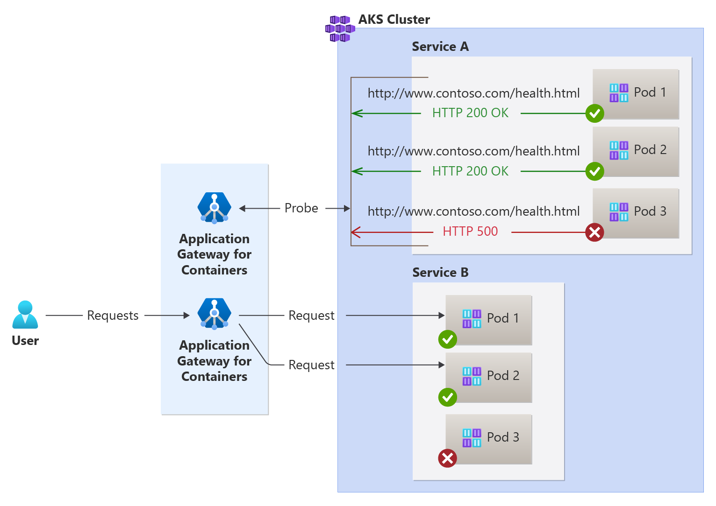
Custom Health Probes
Determine health based on a defined set of criteria
Custom health probe for Azure Application Gateway for Containers | Microsoft Learn

Slide 24
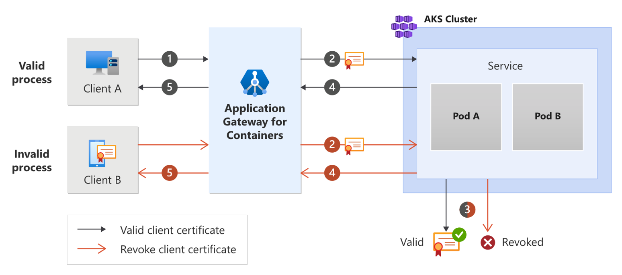
Backend Mutual Authentication
Authenticate to backend targets via client certificate
Backend MTLS with Application Gateway for Containers - Gateway API | Microsoft Learn

Slide 25
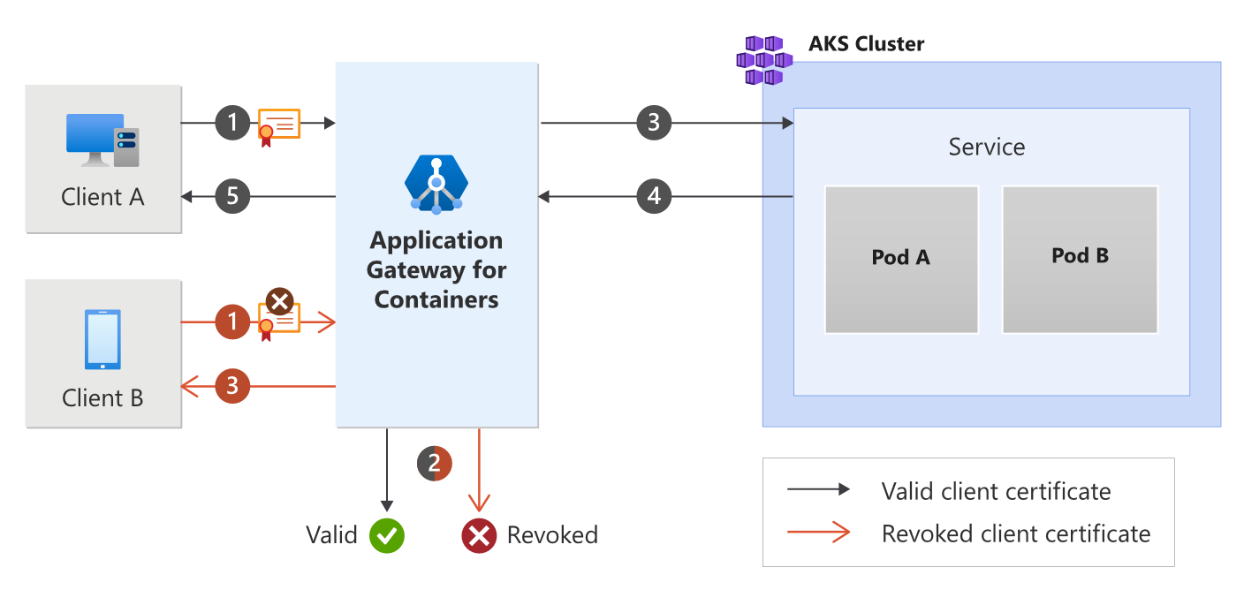
Frontend Mutual Authentication
Authenticate clients via a certificate
Backend MTLS with Application Gateway for Containers - Gateway API | Microsoft Learn

Slide 26
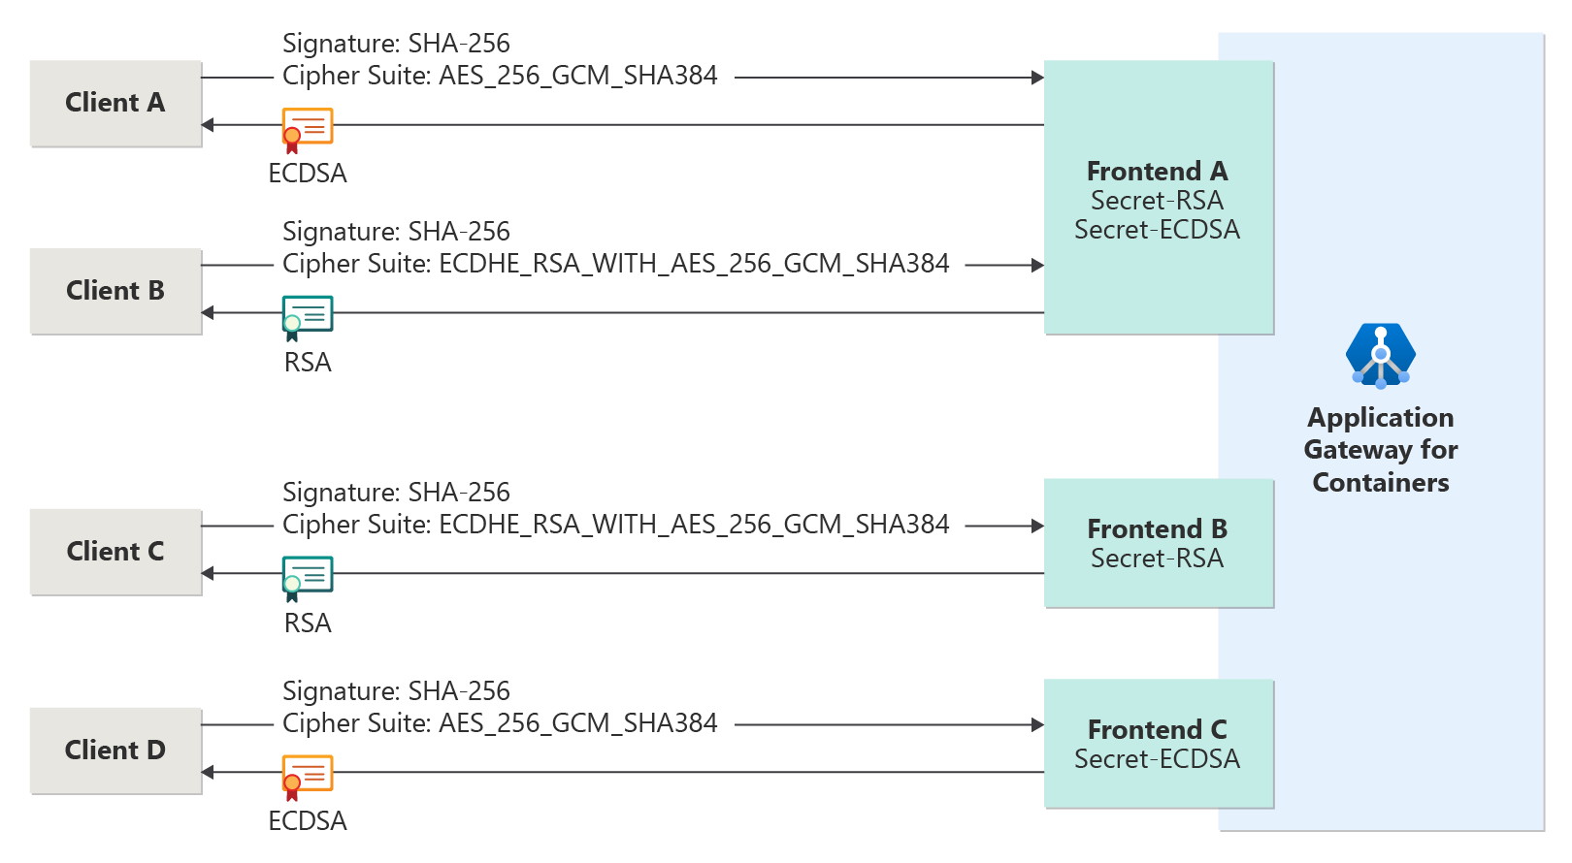
ECDSA + RSA Certificates
Leverage ECDSA and RSA certificates for greatest device compatibility and performance
ECDSA and RSA Certificates for Azure Application Gateway for Containers | Microsoft Learn

Slide 27
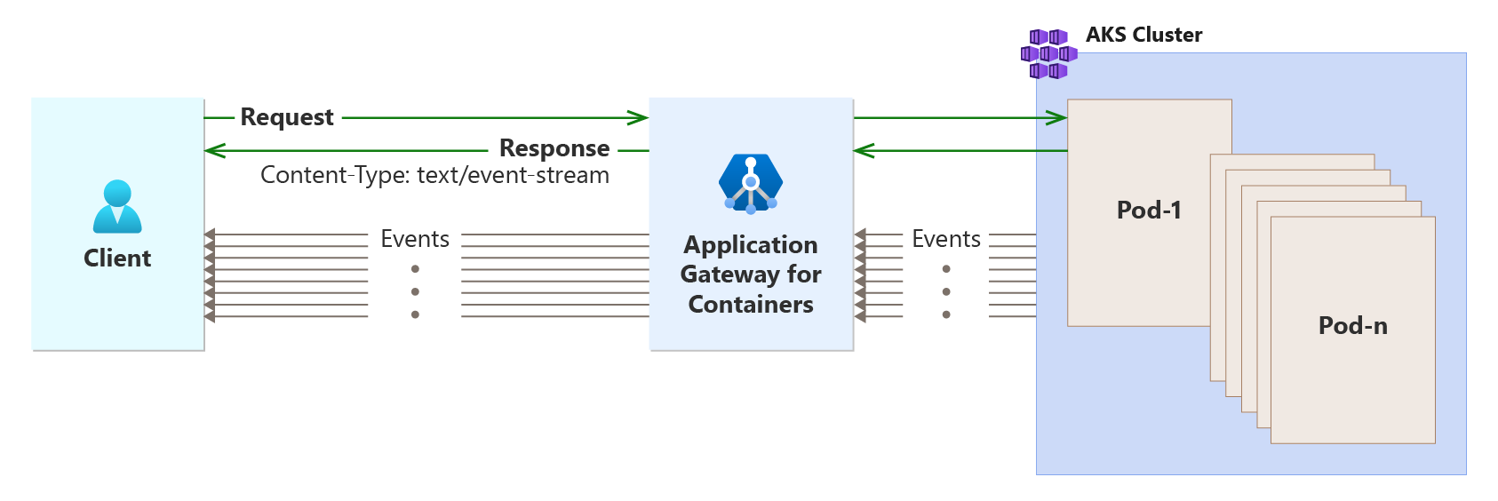
Server-sent events (SSE)
Enable servers to push real-time updates to web clients over a single HTTP connection
Server-sent events and Application Gateway for Containers | Microsoft Learn

Slide 28
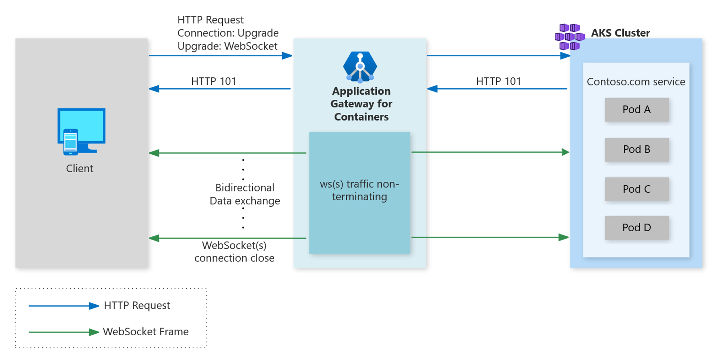
WebSocket Protocol
Established in RFC6455, enable two-way communication between a client and server
Browser compatibility: Nearly all modern web browsers support WebSockets.
Real-time data: WebSockets enable real-time data transfer between client and server.
Efficiency: WebSockets eliminate the need to continuously poll servers to check for updates.
Security: WebSockets can be encrypted using TLS and use standard HTTP ports, such as 80 and 443.
Flexibility: WebSockets can be used for a variety of applications, including chat, gaming, and financial trading platforms.
WebSocket protocol and Application Gateway for Containers | Microsoft Learn

Slide 29
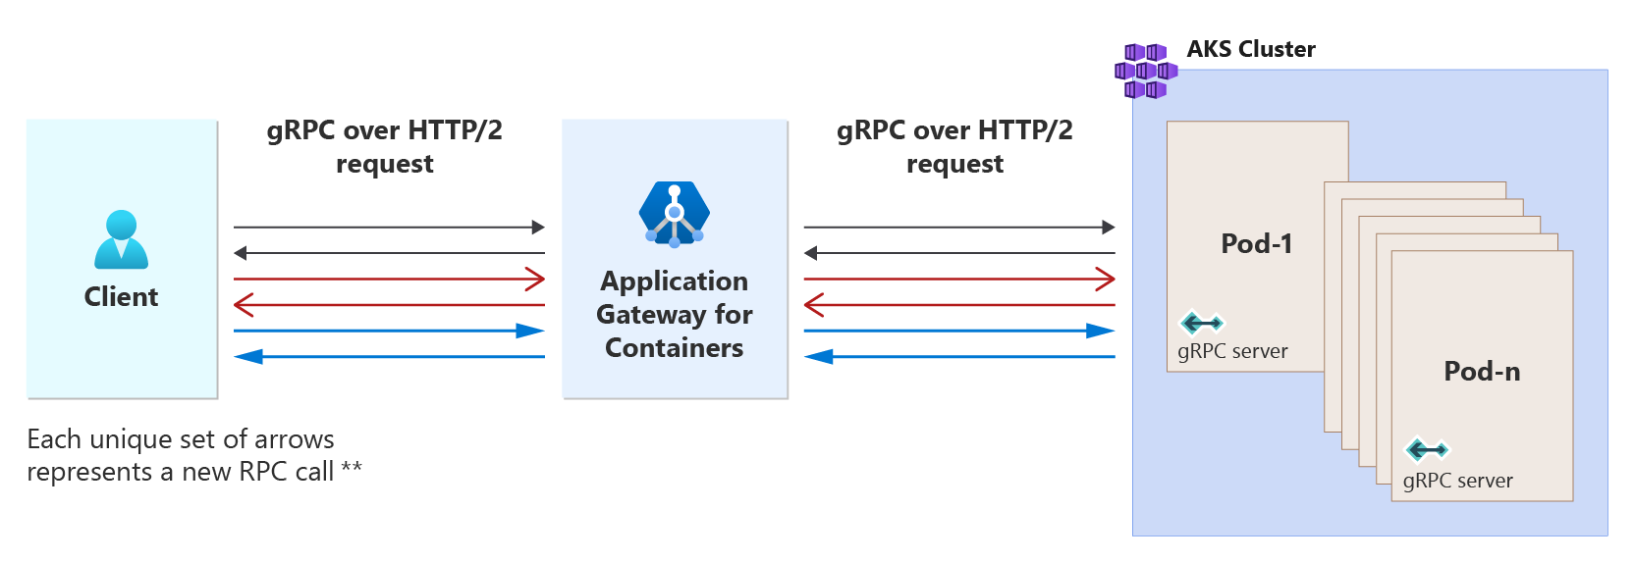
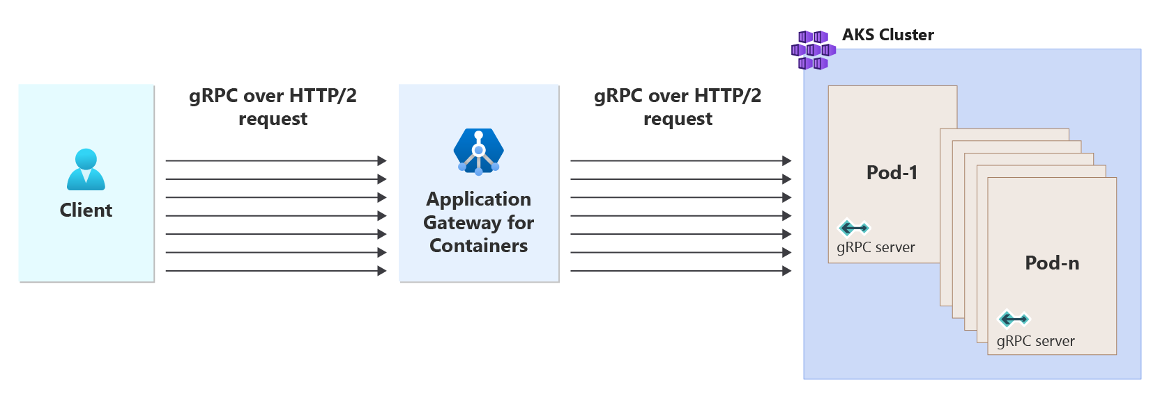
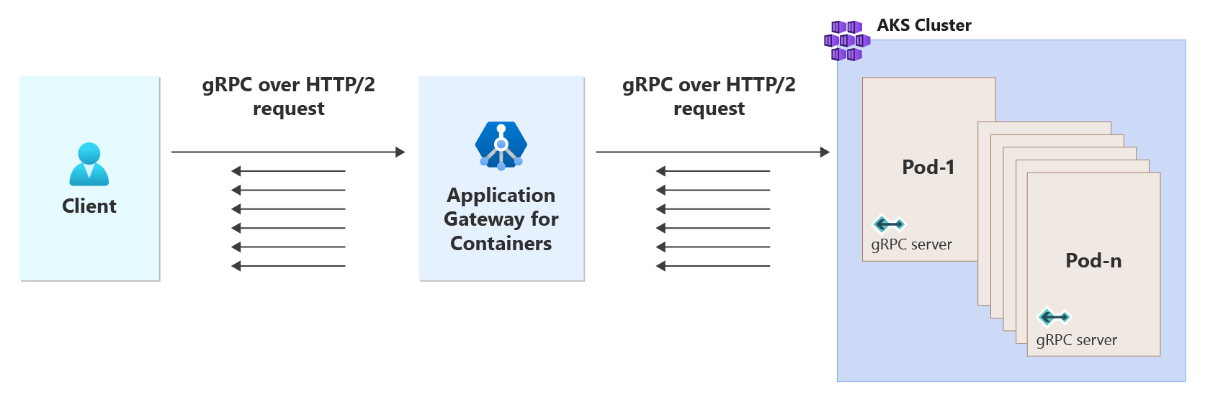
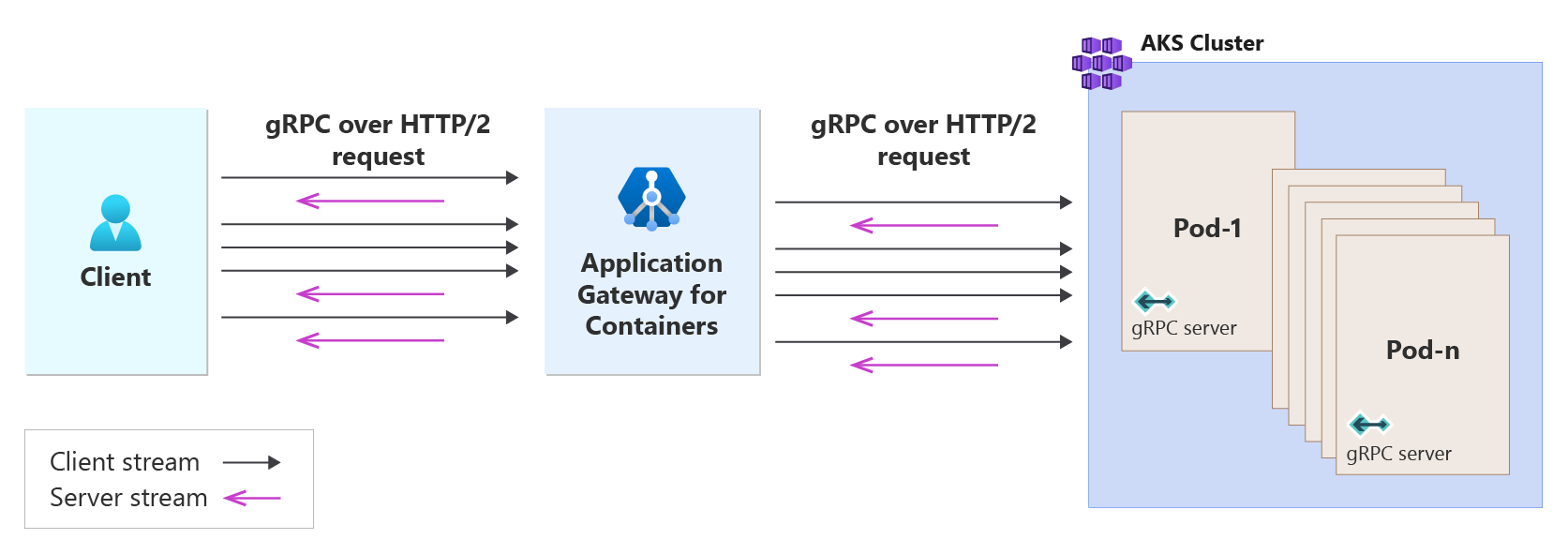
gRPC
Unary RPC
gRPC is lightweight and highly performant protocol; up to 8x faster than JSON serialization with messages 60-80% smaller.
Support for all four life cycles:
Unary
Client-Streaming
Server-Streaming
Bidirectional-Streaming
Client Streaming RPC
Server Streaming RPC
Bidirectional RPC
gRPC with Application Gateway for Containers | Microsoft Learn
29

Slide 30
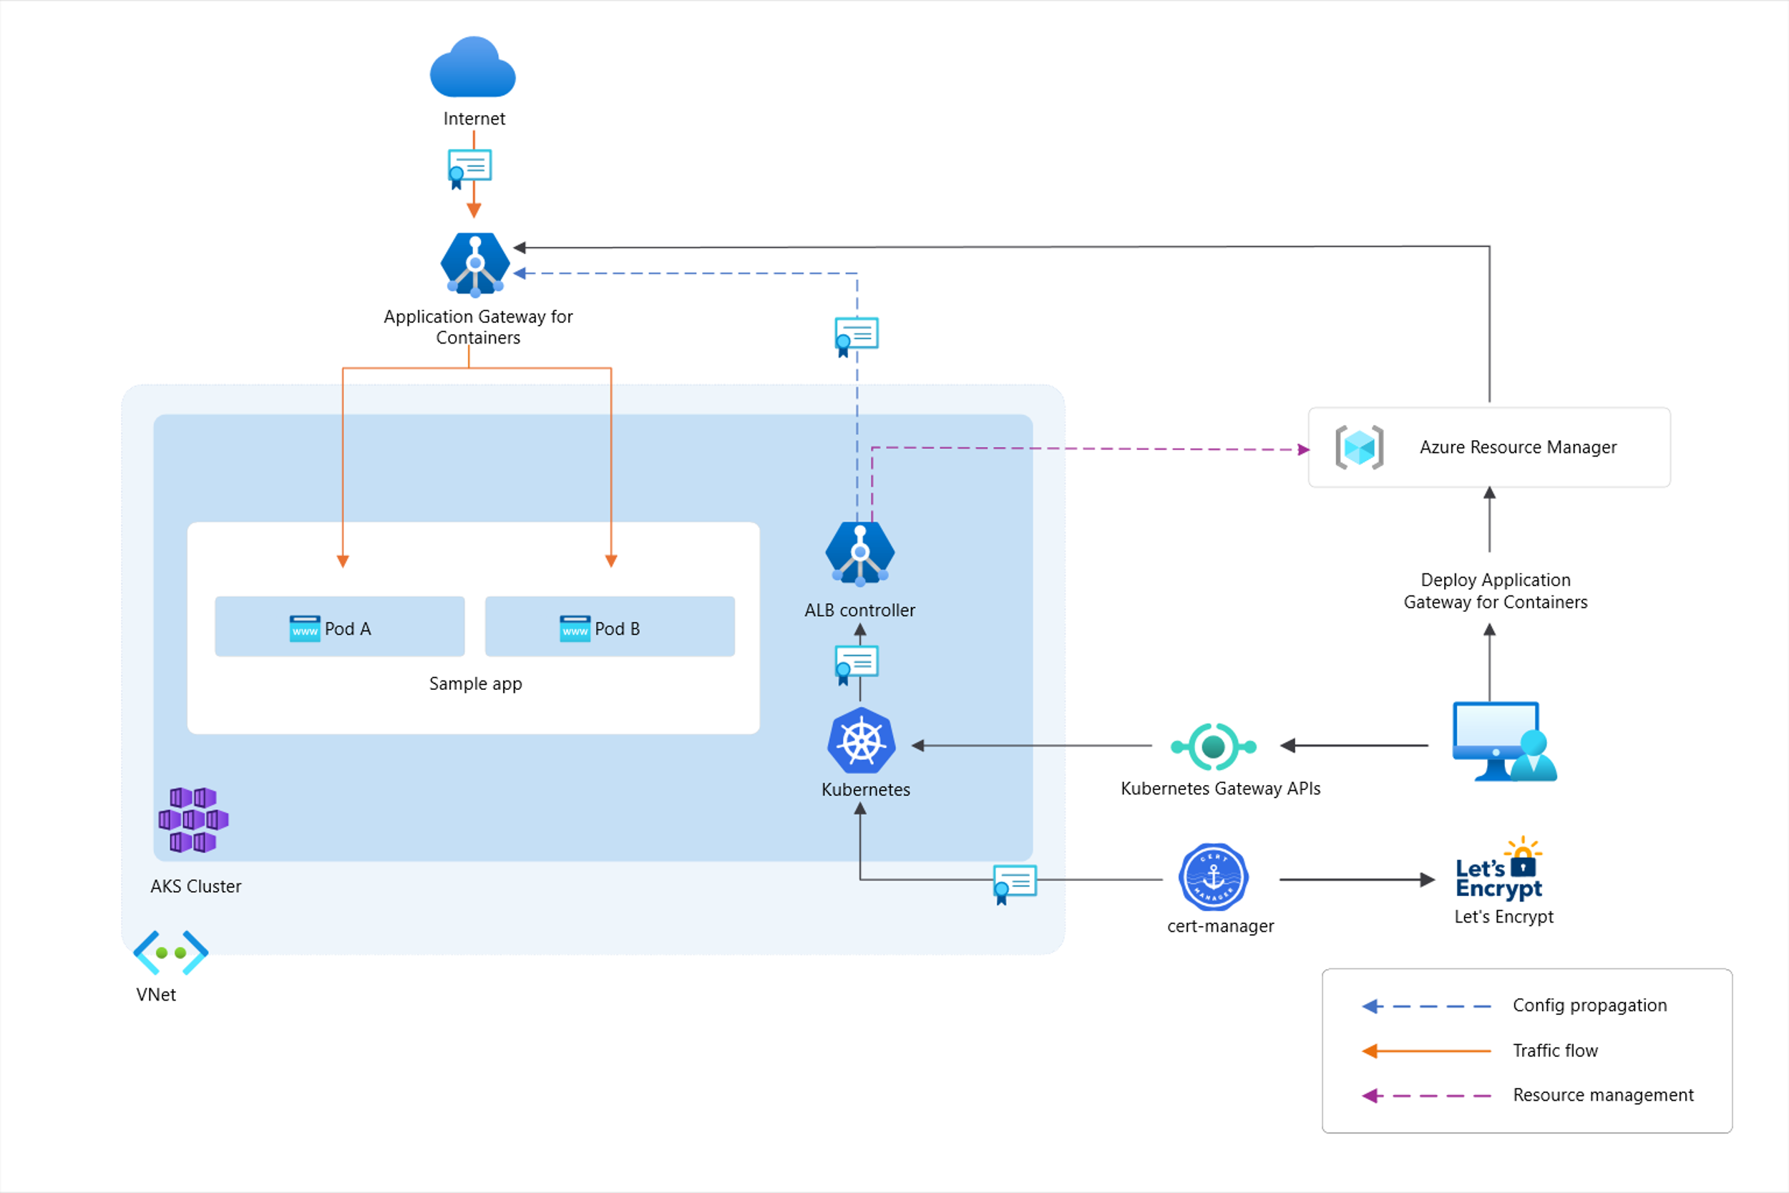
Managed Certificates - cert-manager + Let’s Encrypt
Leverage free TLS certificates for your workloads
Leverages cert-manager
Automated certificate issuance/rotation
Used by 450 million+ websites
SAN certificates are supported
Domain validated certificates via http-01 challenge
Cert-manager and Let's Encrypt with Application Gateway for Containers - Gateway API | Microsoft Learn

Slide 31
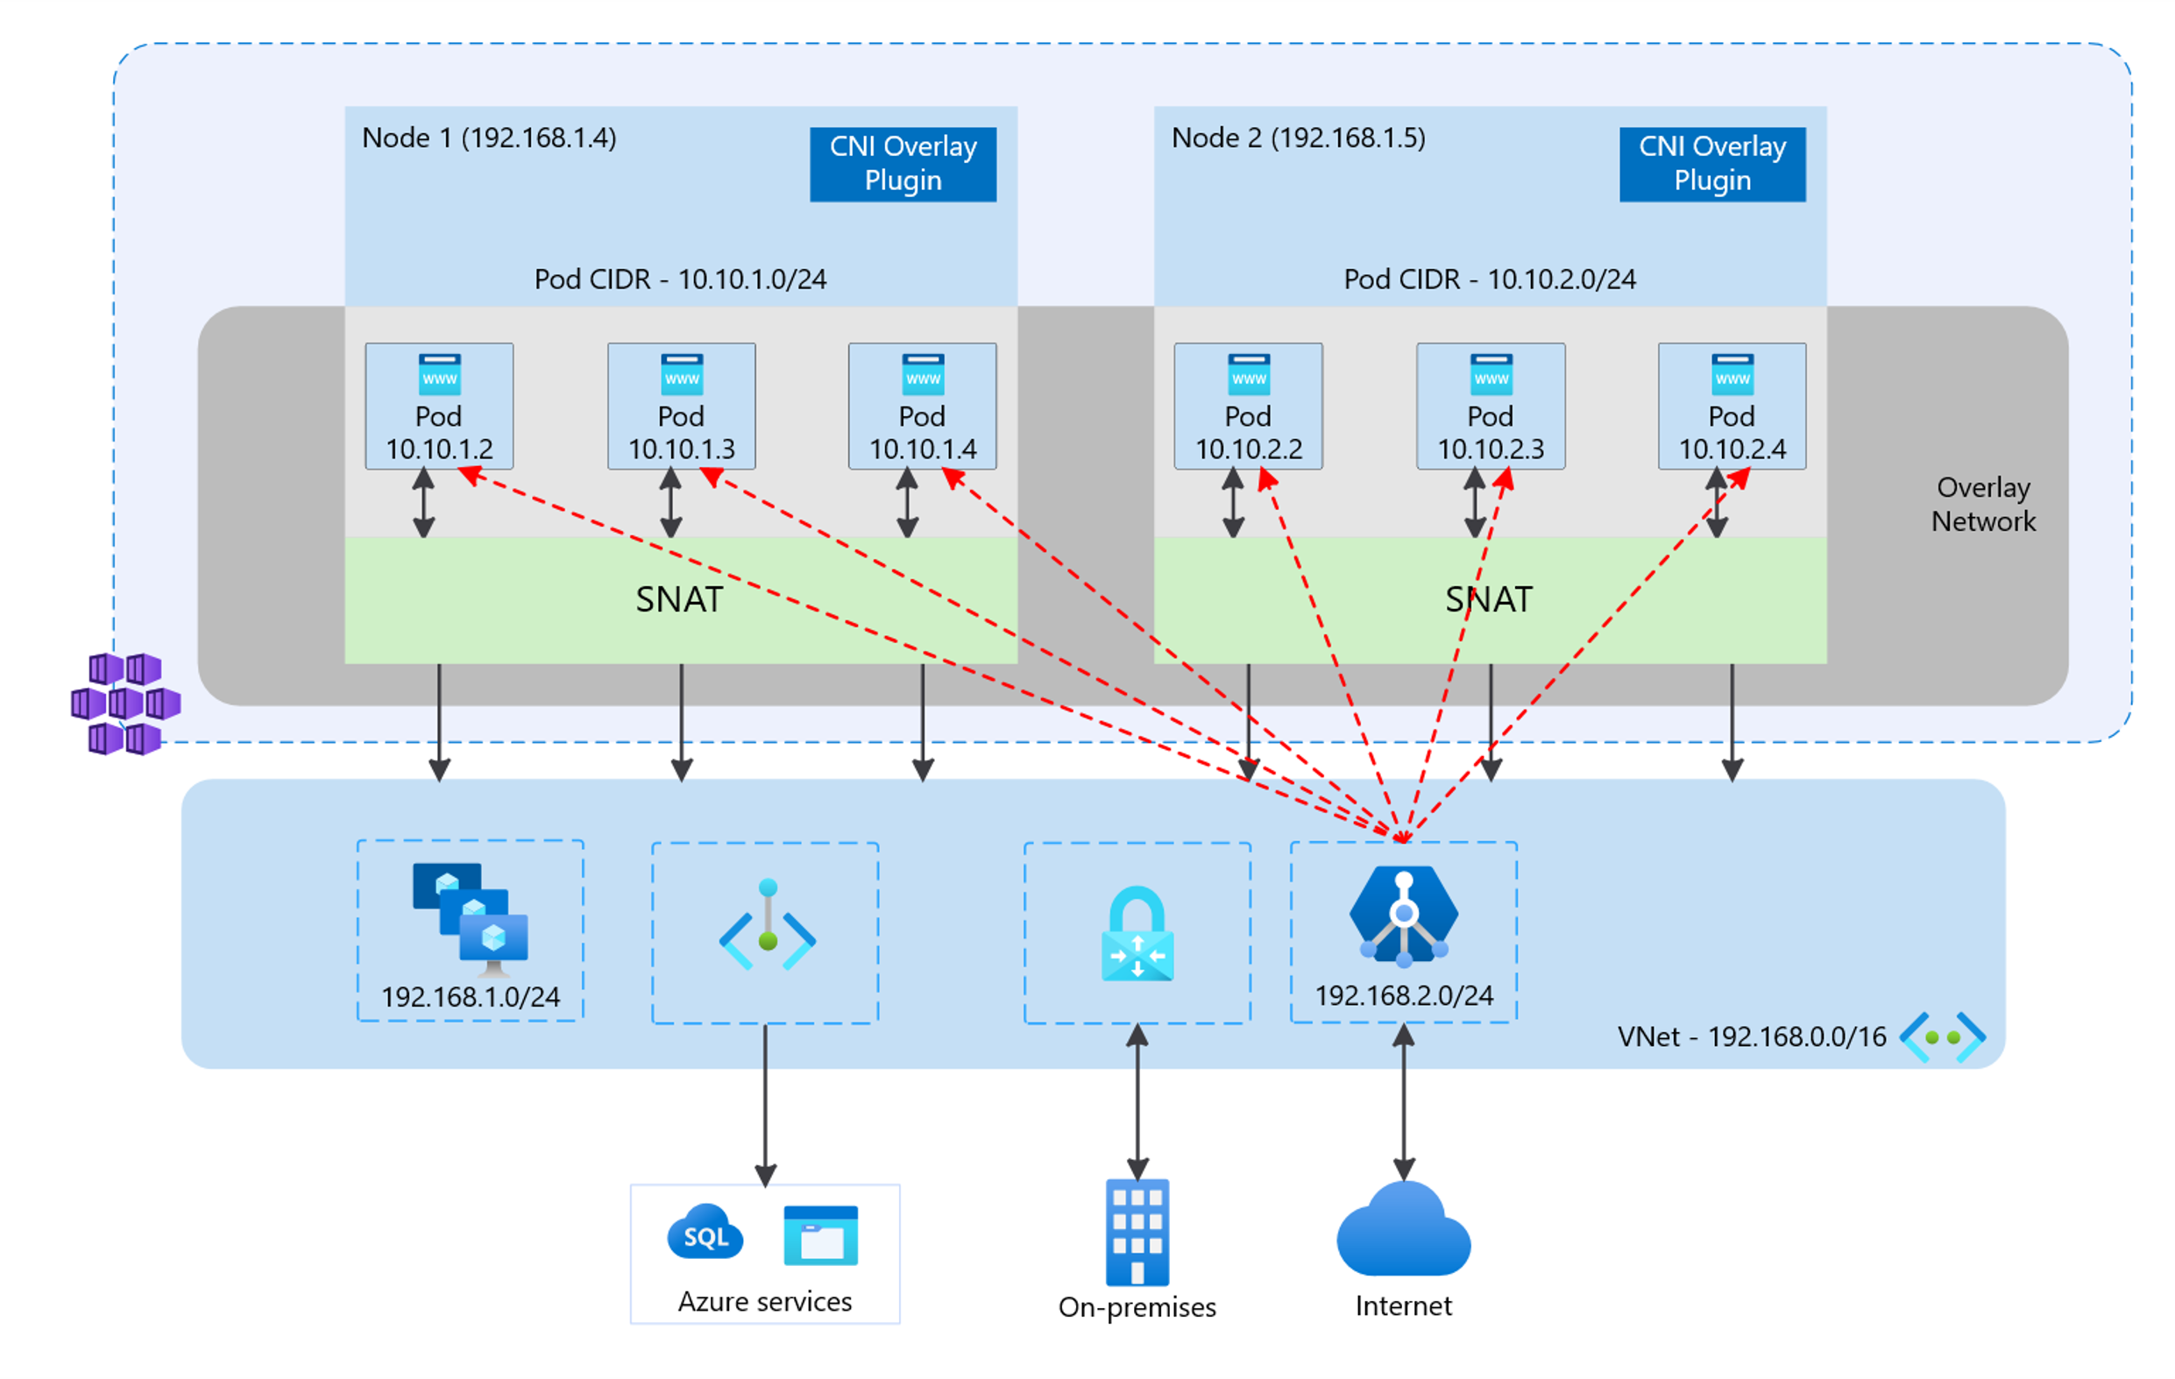
CNI + CNI Overlay
Conserve IP allocations in your Azure Virtual Network with CNI Overlay!
Support for CNI and CNI Overlay
Support for Kubernetes Network Policies
Azure Network Policies, Cilium, Calico
Traffic proxied directly to pods
CNI -> CNI Overlay supported for AGIC/AGC
Kubenet -> CNI Overlay supported for AGIC
Container networking with Azure Application Gateway for Containers | Microsoft Learn

Slide 32
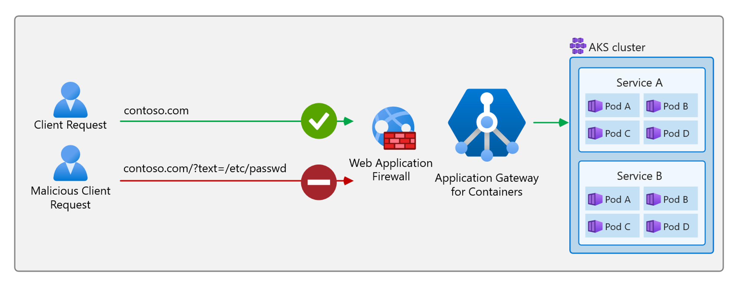
Web Application Firewall
Leverage Web Application Firewall Policy with Application Gateway for Containers!
Features:
Managed & Custom Rules
DRS 2.1 ruleset
Geomatch rules
Bot protection
Scoped assignment
Gateway
Listener
HTTPRoute
Path
Web Application Firewall on Application Gateway for Containers | Microsoft Learn

Slide 33
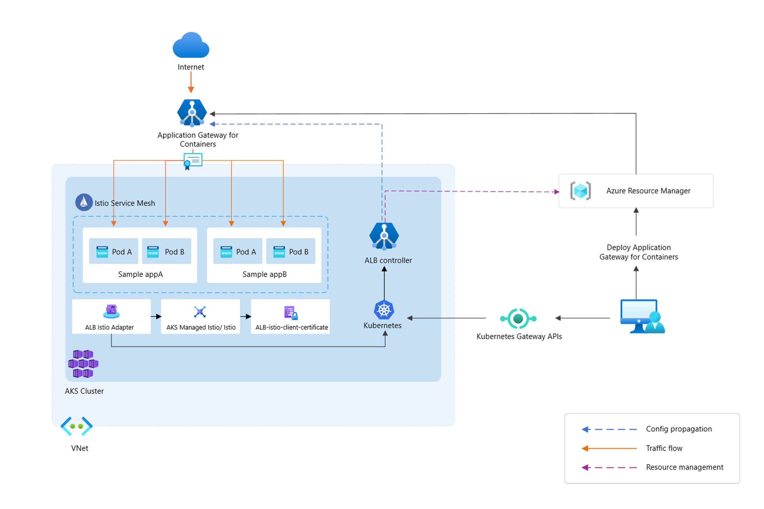
Integration - Istio Mesh (Preview)
Seamless ingress to mesh:
Automatic certificate management; issuance and rotation
Encrypted traffic using mTLS between AGC and service mesh pods
Deployed in HA configuration
Optional installation for those that don’t use Istio

Slide 34
Previews / Roadmap

Slide 35
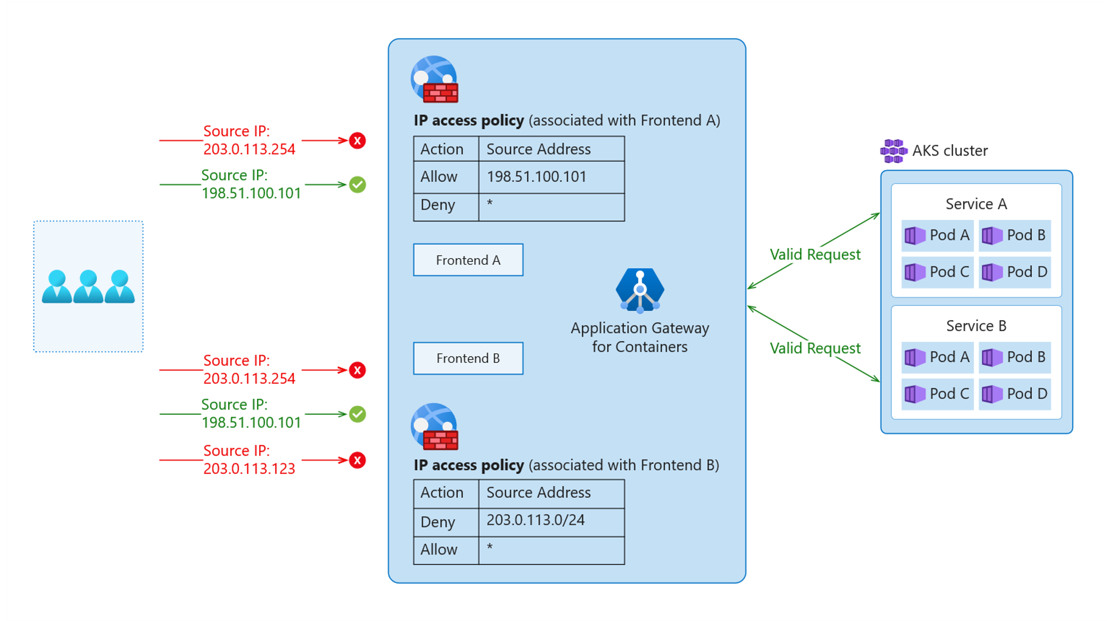
IP Access Policy (Private Preview)
IP Access Policy
Rules supported:
Individual IP addresses
(e.g., 198.51.100.101)
IP prefixes in CIDR notation
(e.g., 198.51.100.0/24)
Wildcard * to match all IPs
Scoped to Frontend resource
Up to 100 rules per policy

Slide 36
Application Gateway for Containers: Add-on
Ready for review
Public Preview
Click-deploy installation of ALB Controller
Cluster managed updates for ALB controller
Leverages managed AKS Gateway API add-on
Add-on

Slide 37
Application Gateway for Containers: Load Aware Routing
Ready for review
Public Preview
Distribute traffic to backend pods based on metrics
Implements Open Request Cost Aggregation (ORCA) load report format
Optimize traffic distribution based on a defined metric, such as CPU, Memory, GPU, etc.
Pod A
Pod B
Pod C
0% GPU utilization
50% GPU utilization

Slide 38
Roadmap
App Routing add-on
Frontend Access Rules
Multi-cluster support
AGIC Retirement
Additional regions
Load Balancing Algorithms
Slow Start
Load Aware Routing
Circuit Breaker
Priority

